Slide 1
Intern2Grow
Sales Data Analysis

Slide 2
Agenda:
1. What was the total revenue generated by the company over the course of the year?
2. Which product had the highest revenue? How much revenue did it generate?
3. What was the average price of a product sold by the company?
4. What was the total quantity of products sold by the company?
5.What was the average revenue per sale?
6. Which category had the highest revenue? How much revenue did it generate?
7. What was the total revenue generated in each quarter of the year?

Slide 3
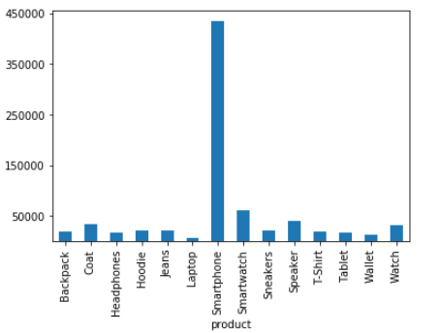
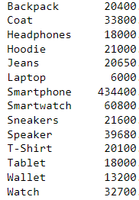
1-We have a 369 order during the last year
Total revenue is : 760330
The highest product revenue is : Smartphone
With total revenue : 434400

Slide 4
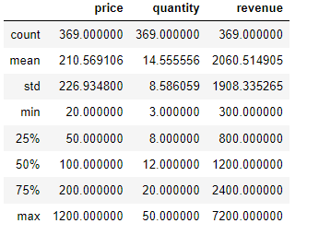



Average price of product is : 210
Total quantity of product : 5371
Avarage revenue per sale : 2060

Slide 5
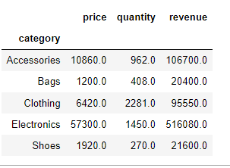
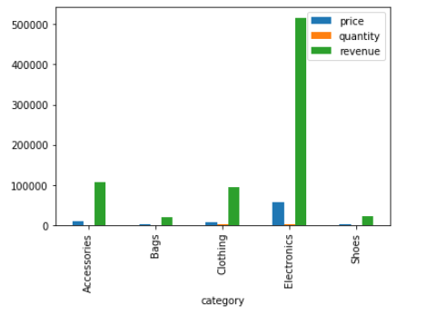
The highest category sales is Electronics with total revenue :516080

Slide 6
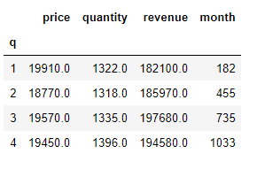
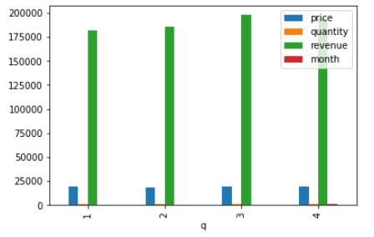
Quarter three has the highest sales by total : 197680

